Slide 1



Retail Sales Performance Analysis Using Python

Slide 2

Course TITLE: Data Analytics
Institute: IEC
Project: Portfolio Project II
Presented By: Sarah zafar

Slide 3
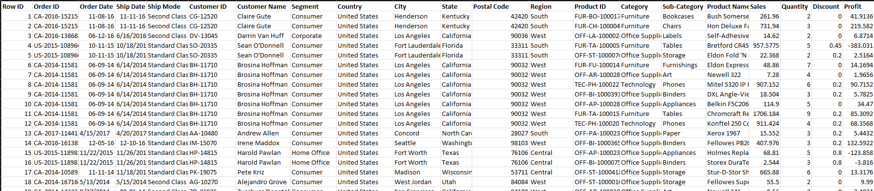
Introduction:
Dataset Description
Dataset: Sample Superstore Sales Dataset
Kaggle Link:
https://www.kaggle.com/datasets/vivek468/superstore-dataset-final
Contains information about:
Orders
Customers
Products
Businesses collect large amounts of sales data.
Analyzing this data helps companies understand performance and improve decision making.
This project analyzes the Superstore dataset to identify sales patterns, profit trends, and business insights.
Machine learning techniques are also applied to predict profit.
Sales
Profit
Discounts
Important Columns:
Sales
Profit
Quantity
Discount
Category
Region
Order Date
Total Columns: 21

Slide 4
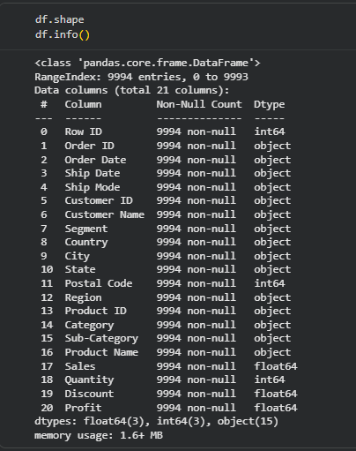
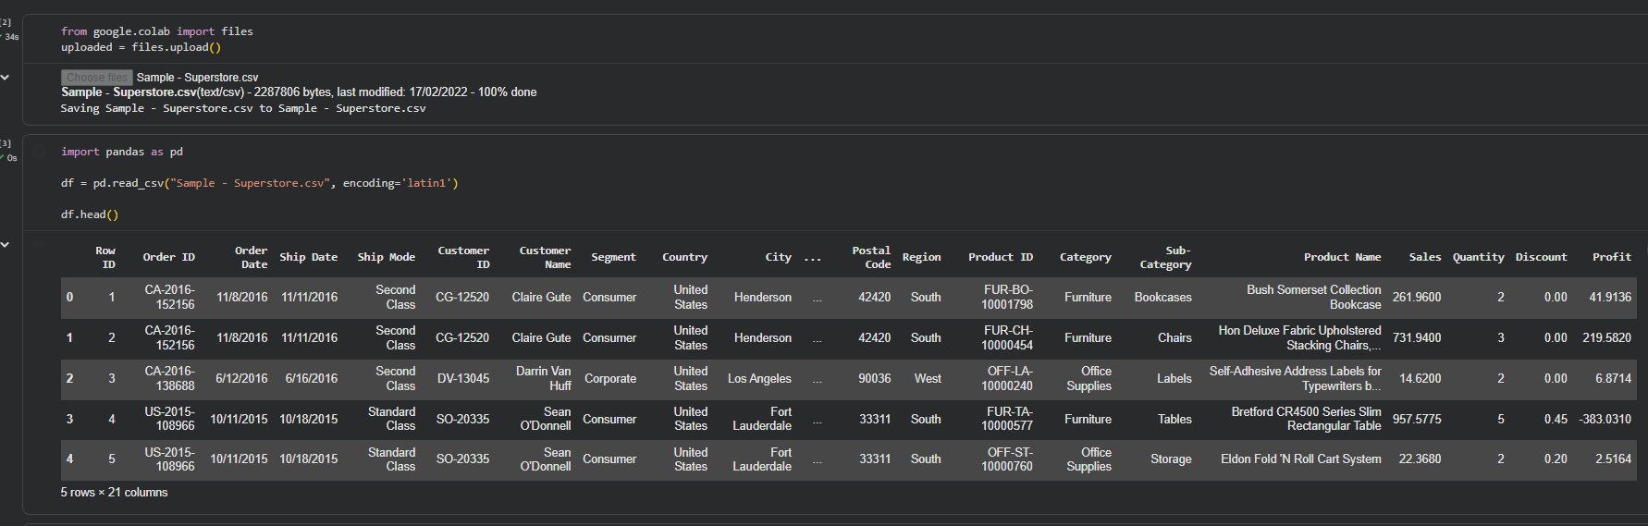
Tools & Technologies
Tools Used:
Programming Language:
Python
Environment:
Google Colab
Libraries Used:
Pandas (data analysis)
NumPy (numerical operations)
Matplotlib (visualization)
Seaborn (data visualization)
Scikit-learn (machine learning)

Slide 5


Data Analysis Process
Methodology
Steps followed in the project:
Data loading
Data cleaning
Exploratory data analysis (EDA)
Data visualization
Feature selection
Machine learning model training
Model evaluation

Slide 6
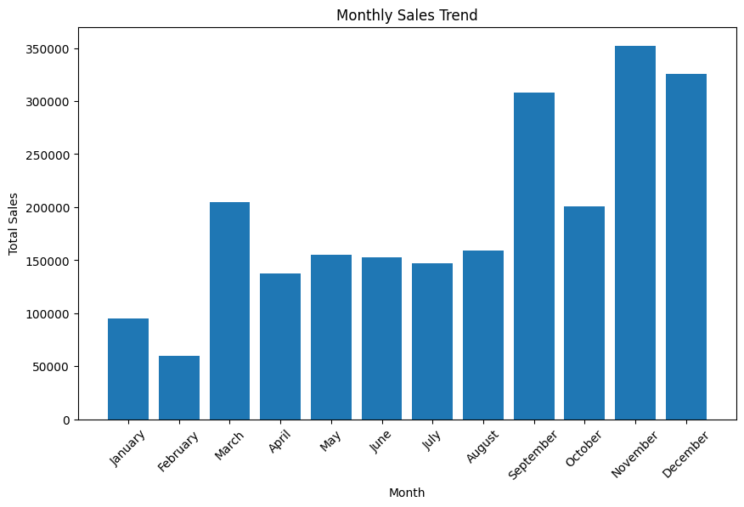
Sales Trend Analysis
This visualization shows sales trends across different months, identifying patterns in customer demand over the years.
This graph is an average of all 4 years of data present in the dataset.
The graph indicates that sales peak in November, closely followed by September & December.
Overall, the second halves of all the years generate the majority of sales.
Businesses can use these insights to plan inventory, promotions, and marketing strategies more effectively during high-demand periods.

Slide 7
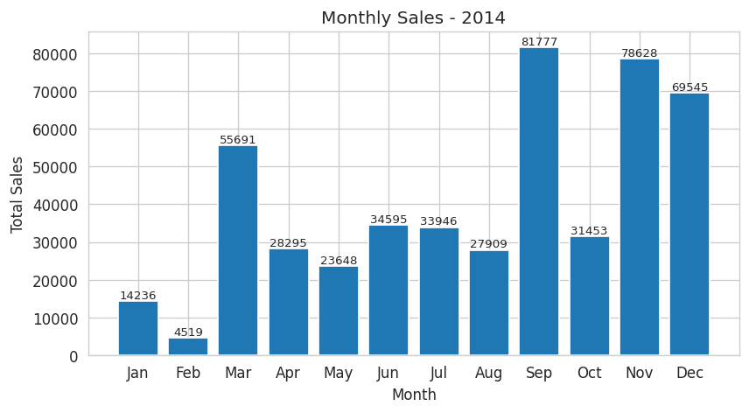
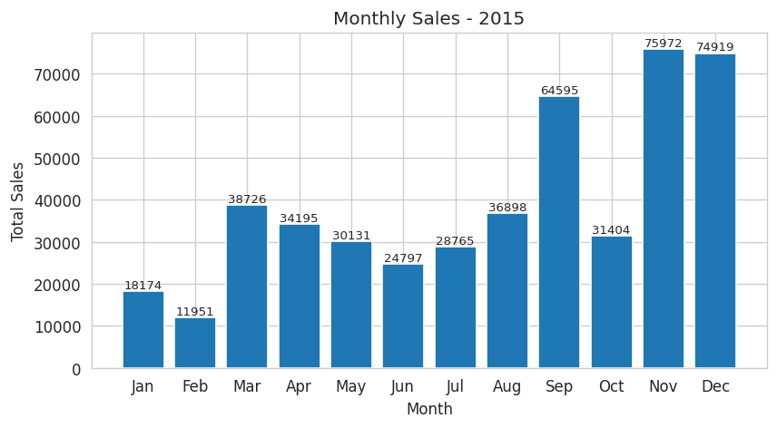
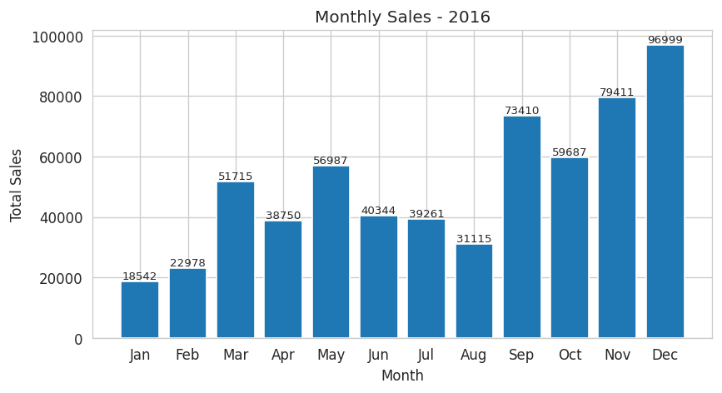
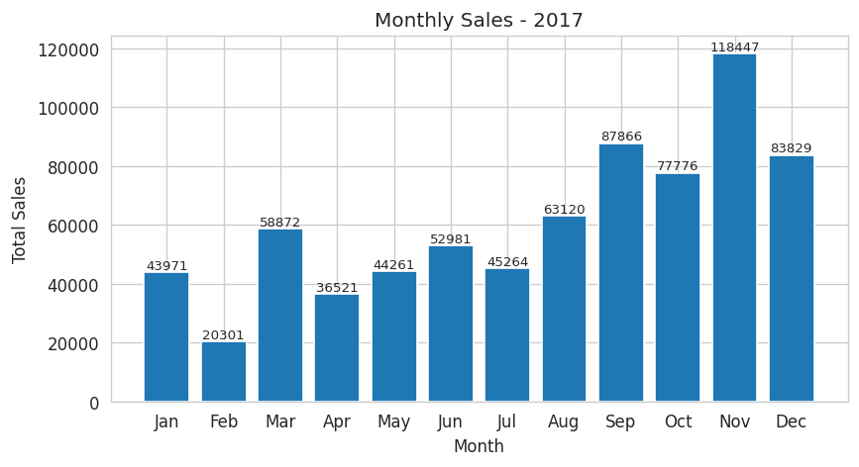
Sales Trend Analysis of Each Separate Year

Slide 8
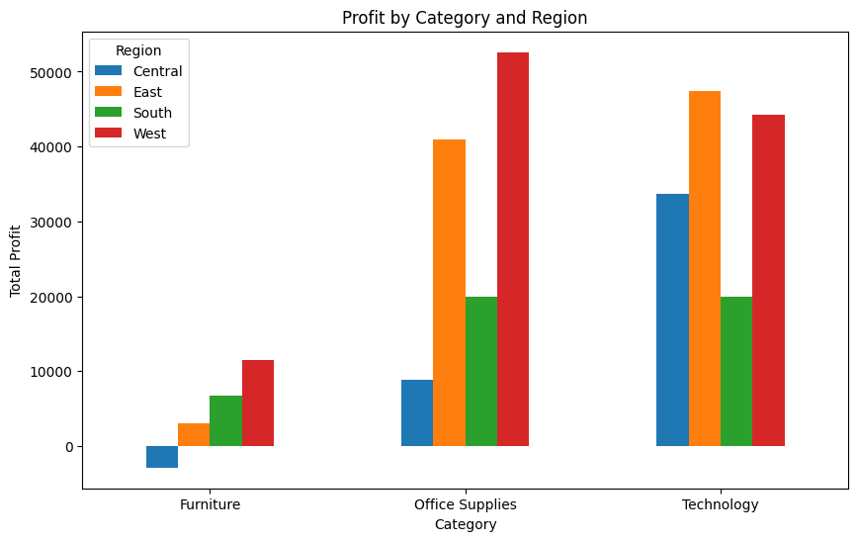
Profit by Category and Region
The West region generated the highest profit in Office Supplies, exceeding $50,000.
The East region followed with around $40,000.
In the Technology category, the East region achieved ~$50,000.
The West region was close behind at ~$45,000.
The Furniture category shows low profitability across all regions, with profits below $10,000.
The Central region experienced losses in Furniture, indicating potential pricing or demand issues.

Slide 9
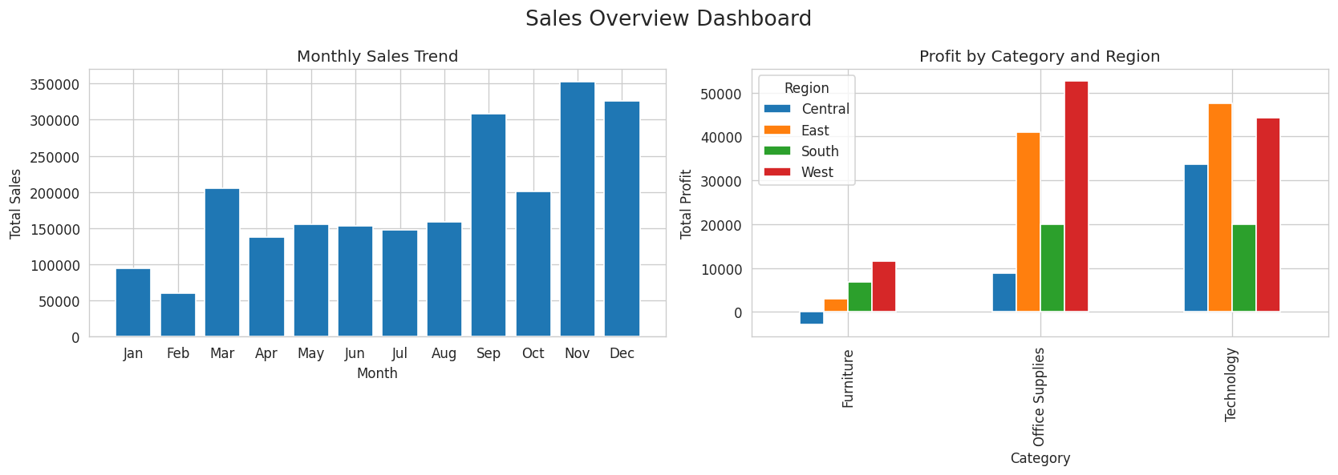
Sales Overview Dashboard
A dashboard created to provide a combined view of sales performance and profitability across regions.
The monthly sales chart highlights seasonal demand patterns, while the category-region chart compares profitability across product categories in different regions.

Slide 10
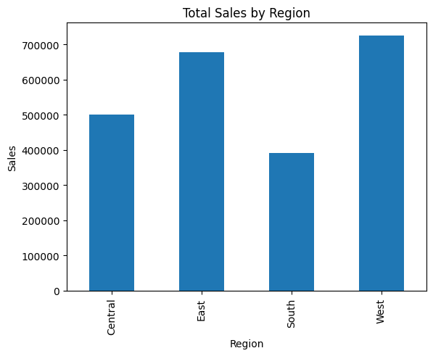
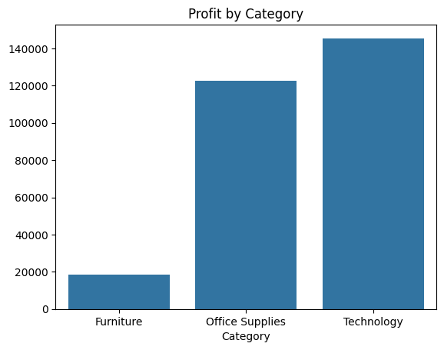
Sales & Profit Overview
An overview of the comparison of total sales among the 4 regions shows that the West region has the highest sales($700,000), closely followed by the East.
A comparison of the 3 product categories shows that Technology($140,000) and Office Supplies($120,000) categories are the most profitable ones.

Slide 11
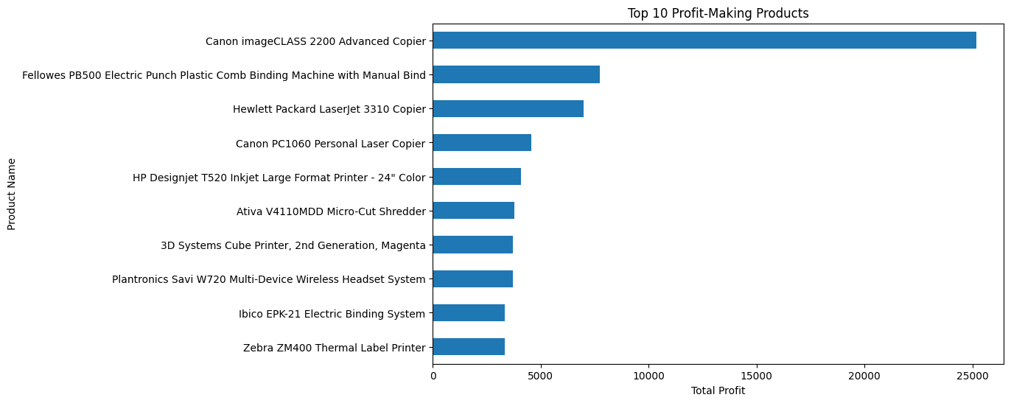
Top 10 Profit-Making Products
This visualization shows that the most profitable product in this superstore is the Canon imageCLASS 2200 Advanced Copier, with almost $25,000 in total profits.
It also shows a stark difference in the staggering profit amounts as compared to other products that barely have $10,000 or below in profits.

Slide 12
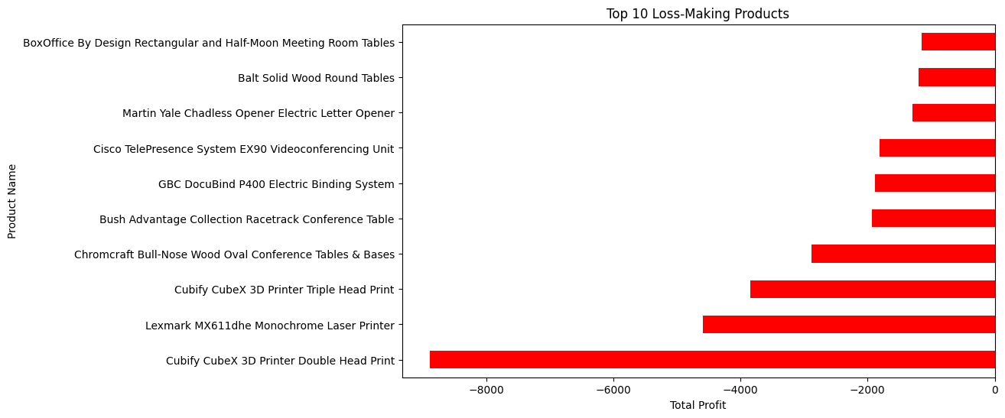
Top 10 Loss-Making Products
This visualization shows that the most loss-making product in this superstore are the Cubify CubeX 3D Printer Double Head Prints, causing almost $9000 in total loss for the company.
It also shows a stark difference in the staggering loss amounts as compared to other products that cause losses mainly below $6000. Most of them lie in the categories of tables or printers.

Slide 13
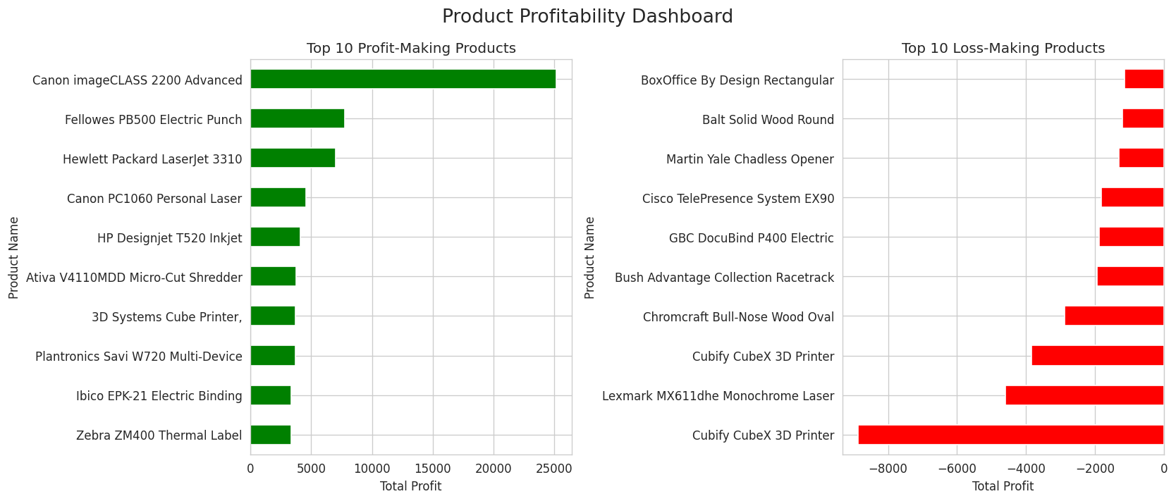
Product Profitability Dashboard
This dashboard highlights the products contributing the most to profits as well as those generating the highest losses.
Identifying these products helps businesses focus on profitable items while reviewing pricing or discount strategies for loss-generating products.

Slide 14
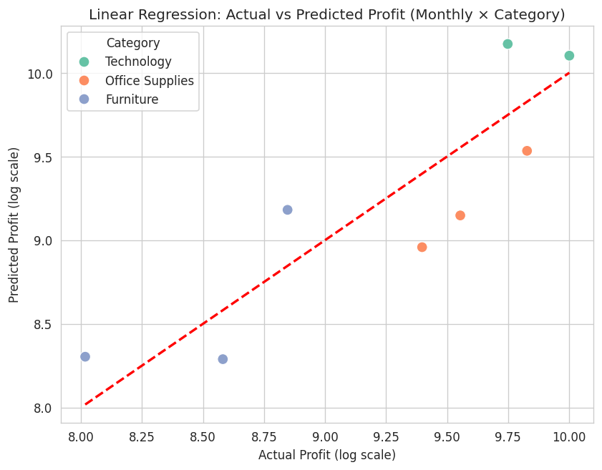
Predicting Monthly Profit Using Robust Linear Regression
Objective:
Predict monthly profit for each product category to support inventory, promotions, and business planning.
Data & Features:
Numerical: Sales, Quantity, Discount, Sales×Quantity, Discount×Quantity
Categorical: Category (Office Supplies, Technology; Furniture as base)
Target: Log-transformed Profit → reduces impact of extreme values

Slide 15
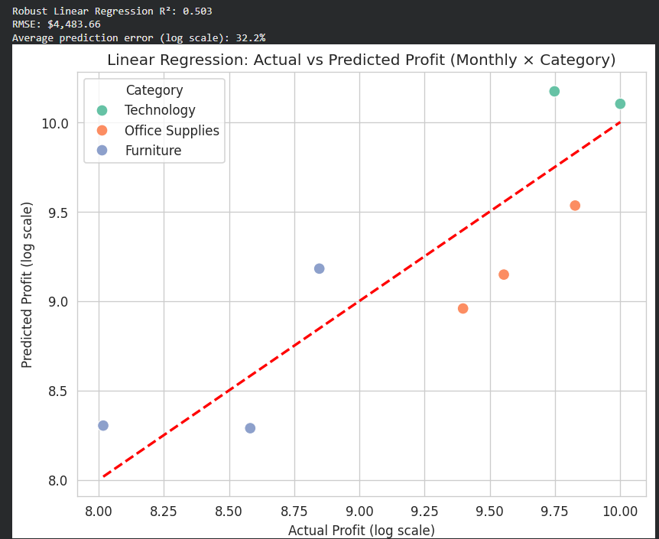
Predicting Monthly Profit Using Robust Linear Regression
Why Robust Regression (RANSAC)?
Profit data has outliers (extreme gains/losses)
RANSAC ignores outliers → more stable predictions
Model Performance:
R² = 0.503 → Explains ~50% of profit variability
RMSE = $4,484 → Average deviation per month-category
Avg log-scale error = 32.2% → Predictions reasonably accurate
Insights:
Technology and Office Supplies profits predicted most accurately
Discounts and category type are main drivers of profit

Slide 16
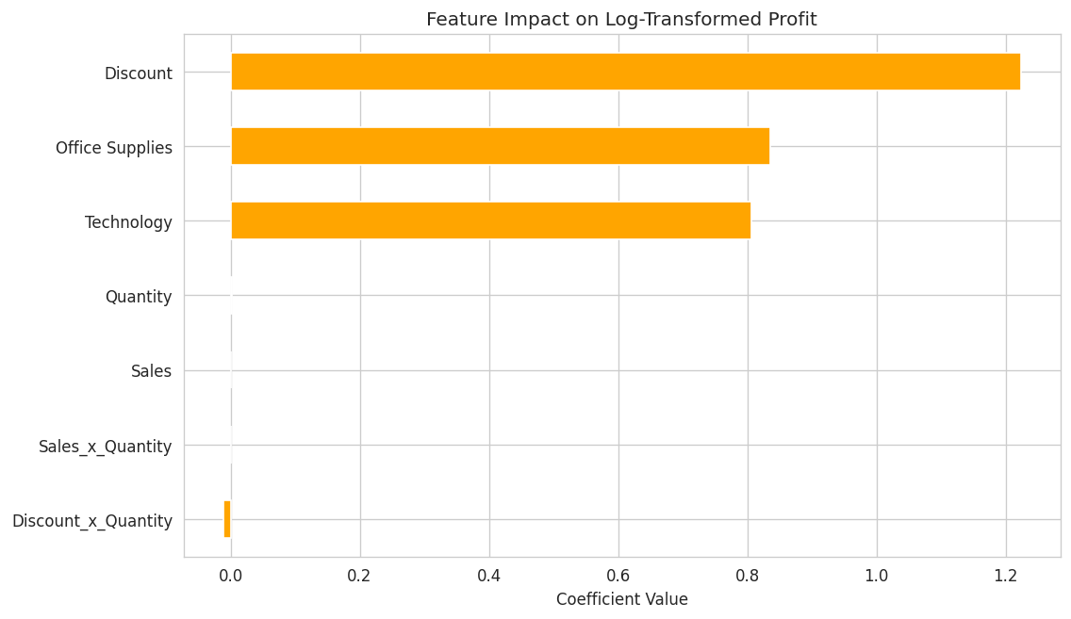
Key Drivers of Profit
Feature Importance (RANSAC Coefficients):
Discount: Strongest positive impact → larger discounts increase profit
Category: Office Supplies & Technology positively affect profit (Furniture as base)
Quantity, Sales, Sales×Quantity:
Minimal direct effect after controlling for category and interactions
Discount×Quantity:
Slight negative effect → large discounts on bulk orders can reduce profit
Business Implications:
Focus promotions on high-margin categories with strategic discounts
Prioritize Technology and Office Supplies for profitability
Avoid excessive discounts on bulk orders that may hurt profit

Slide 17
THANK you

